Slide 1
Ръкоделко –
Пазар за уникални ръкоделия
GitHub Repository: https://github.com/hrisa006/RakodelkoSYS
Изготвено от: Христиана Караиванова, Ф.н.: 3MI0700178, ИС, III курс

Slide 2
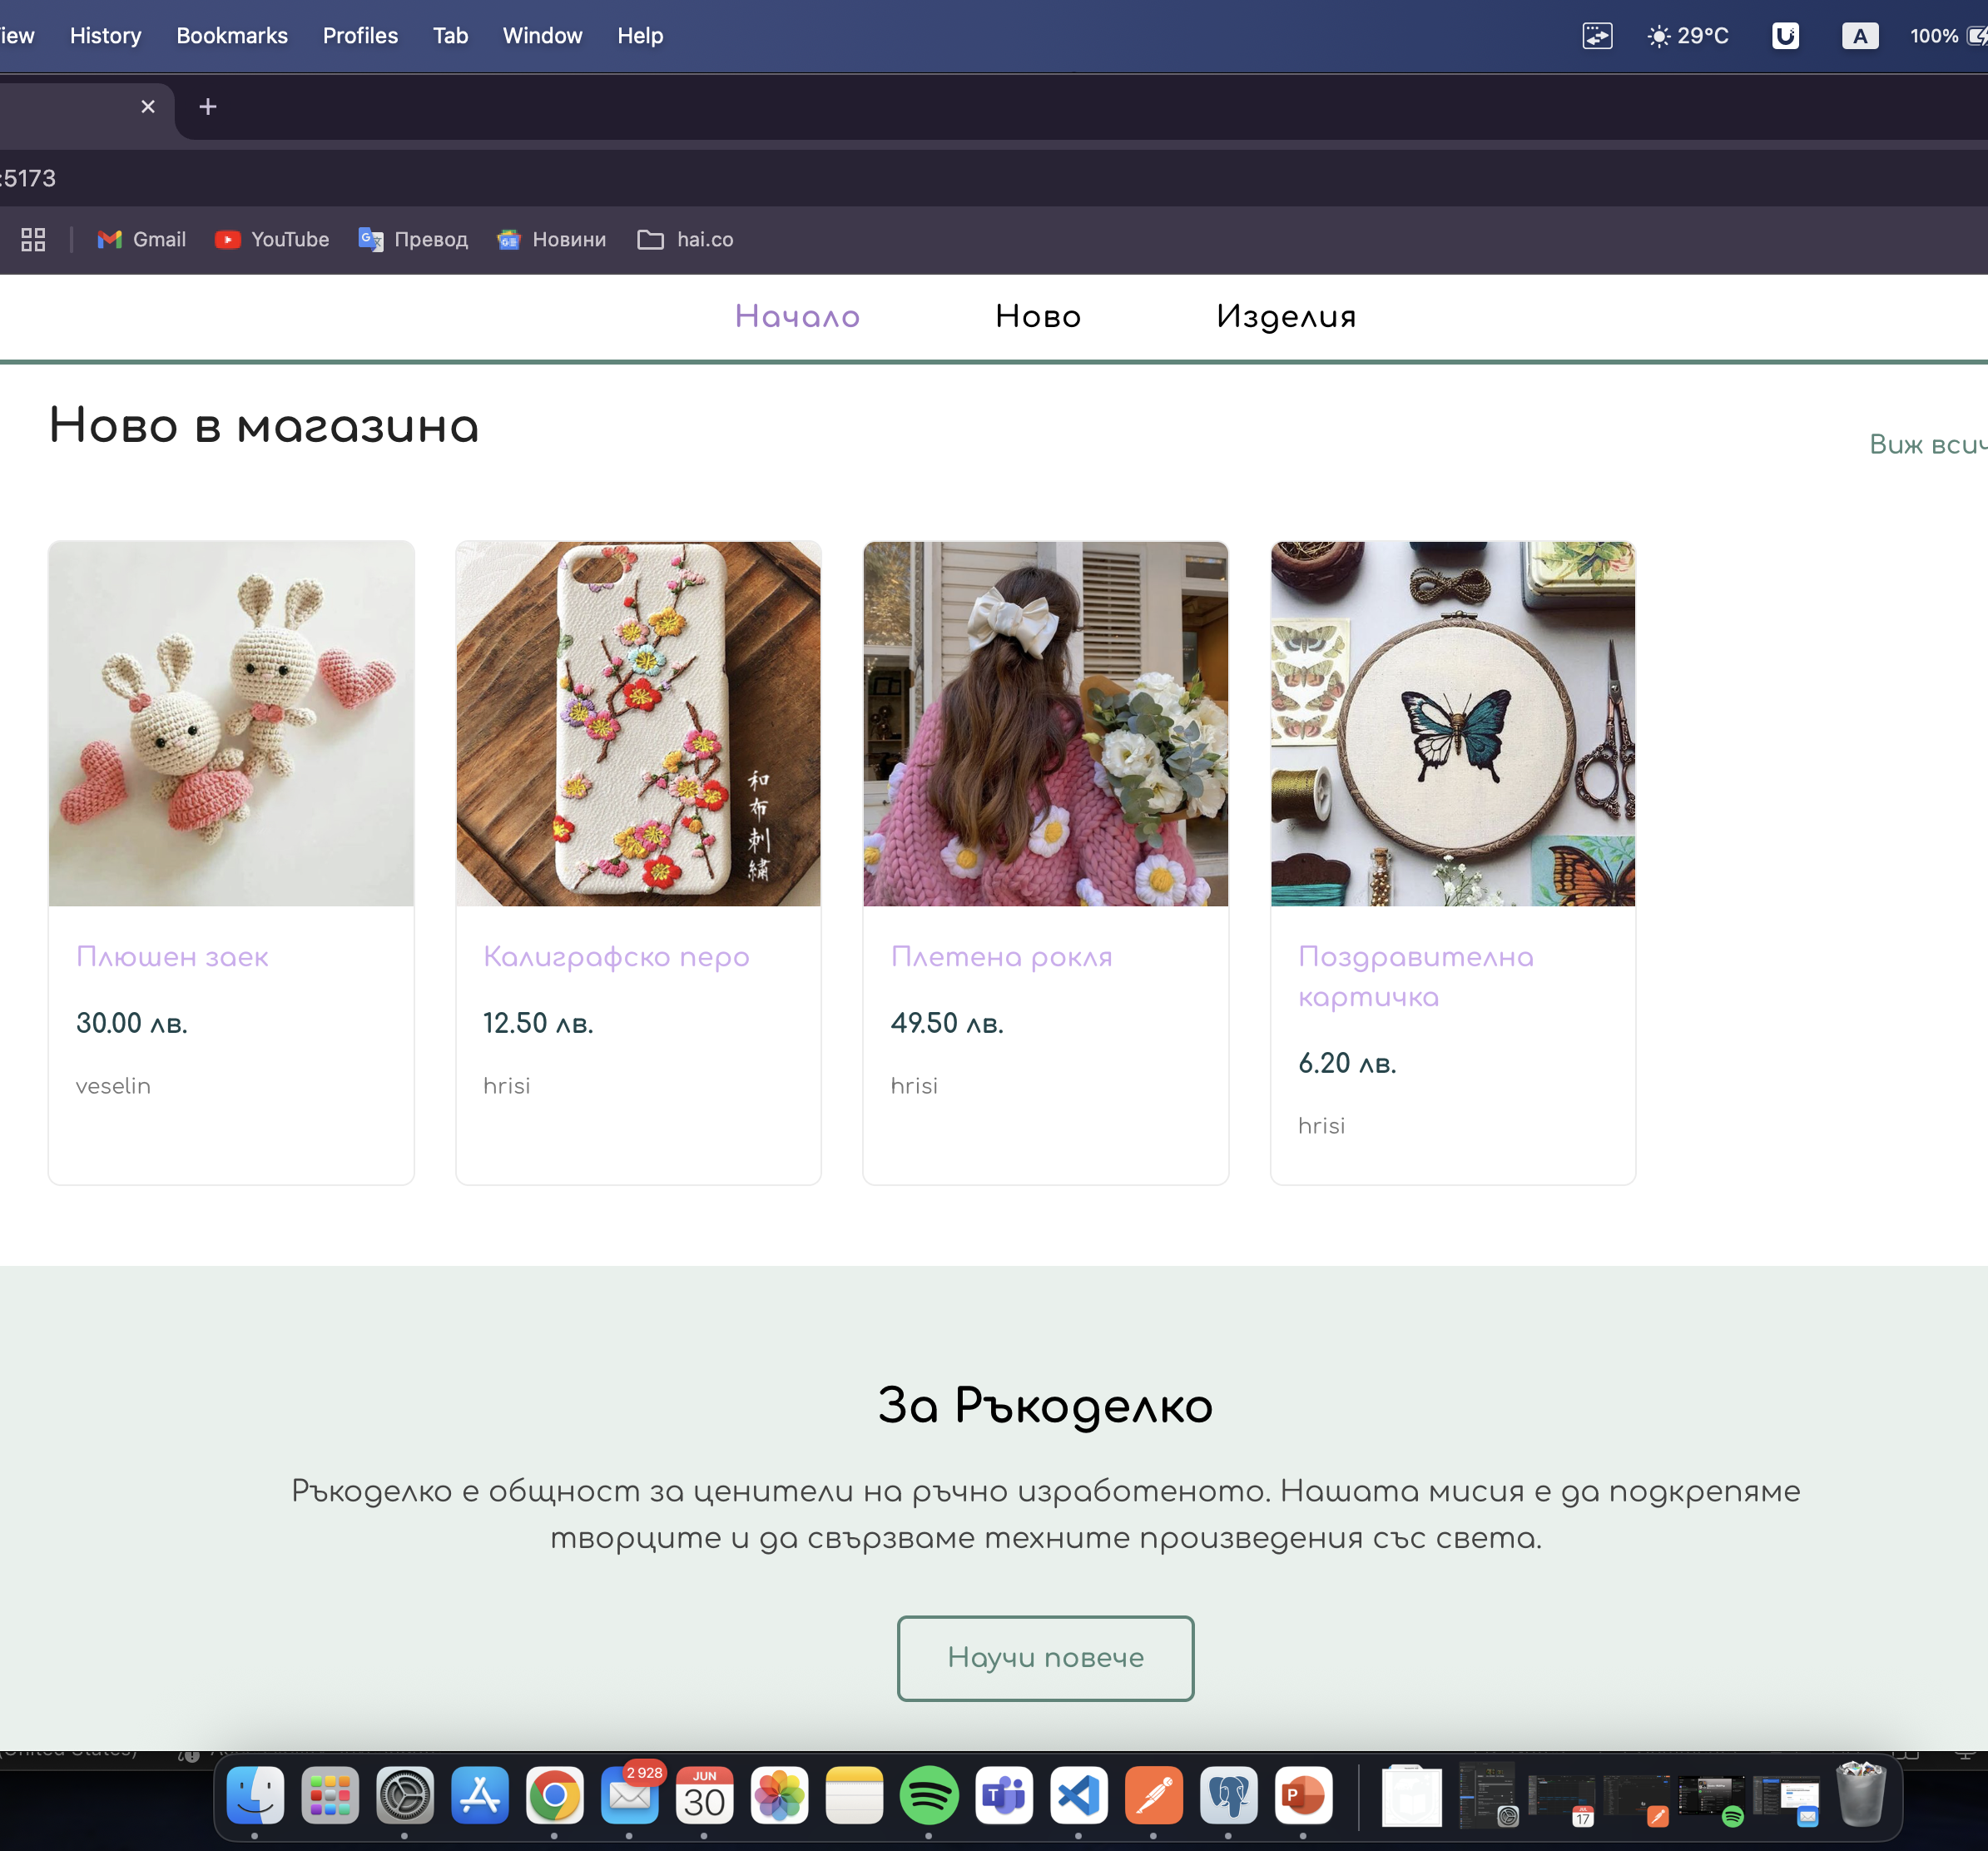
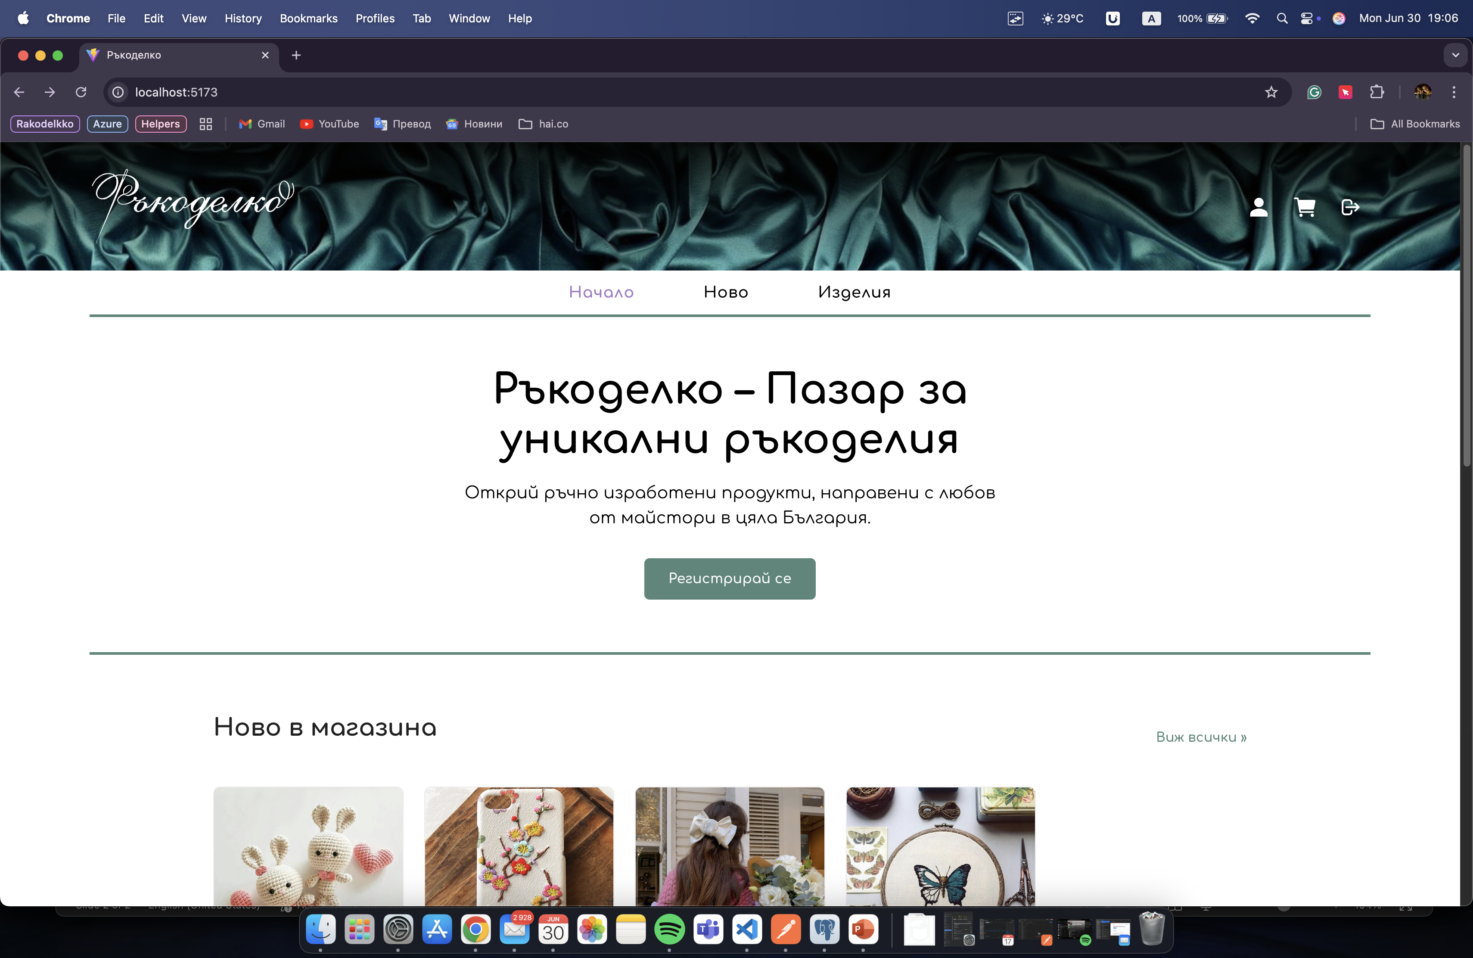
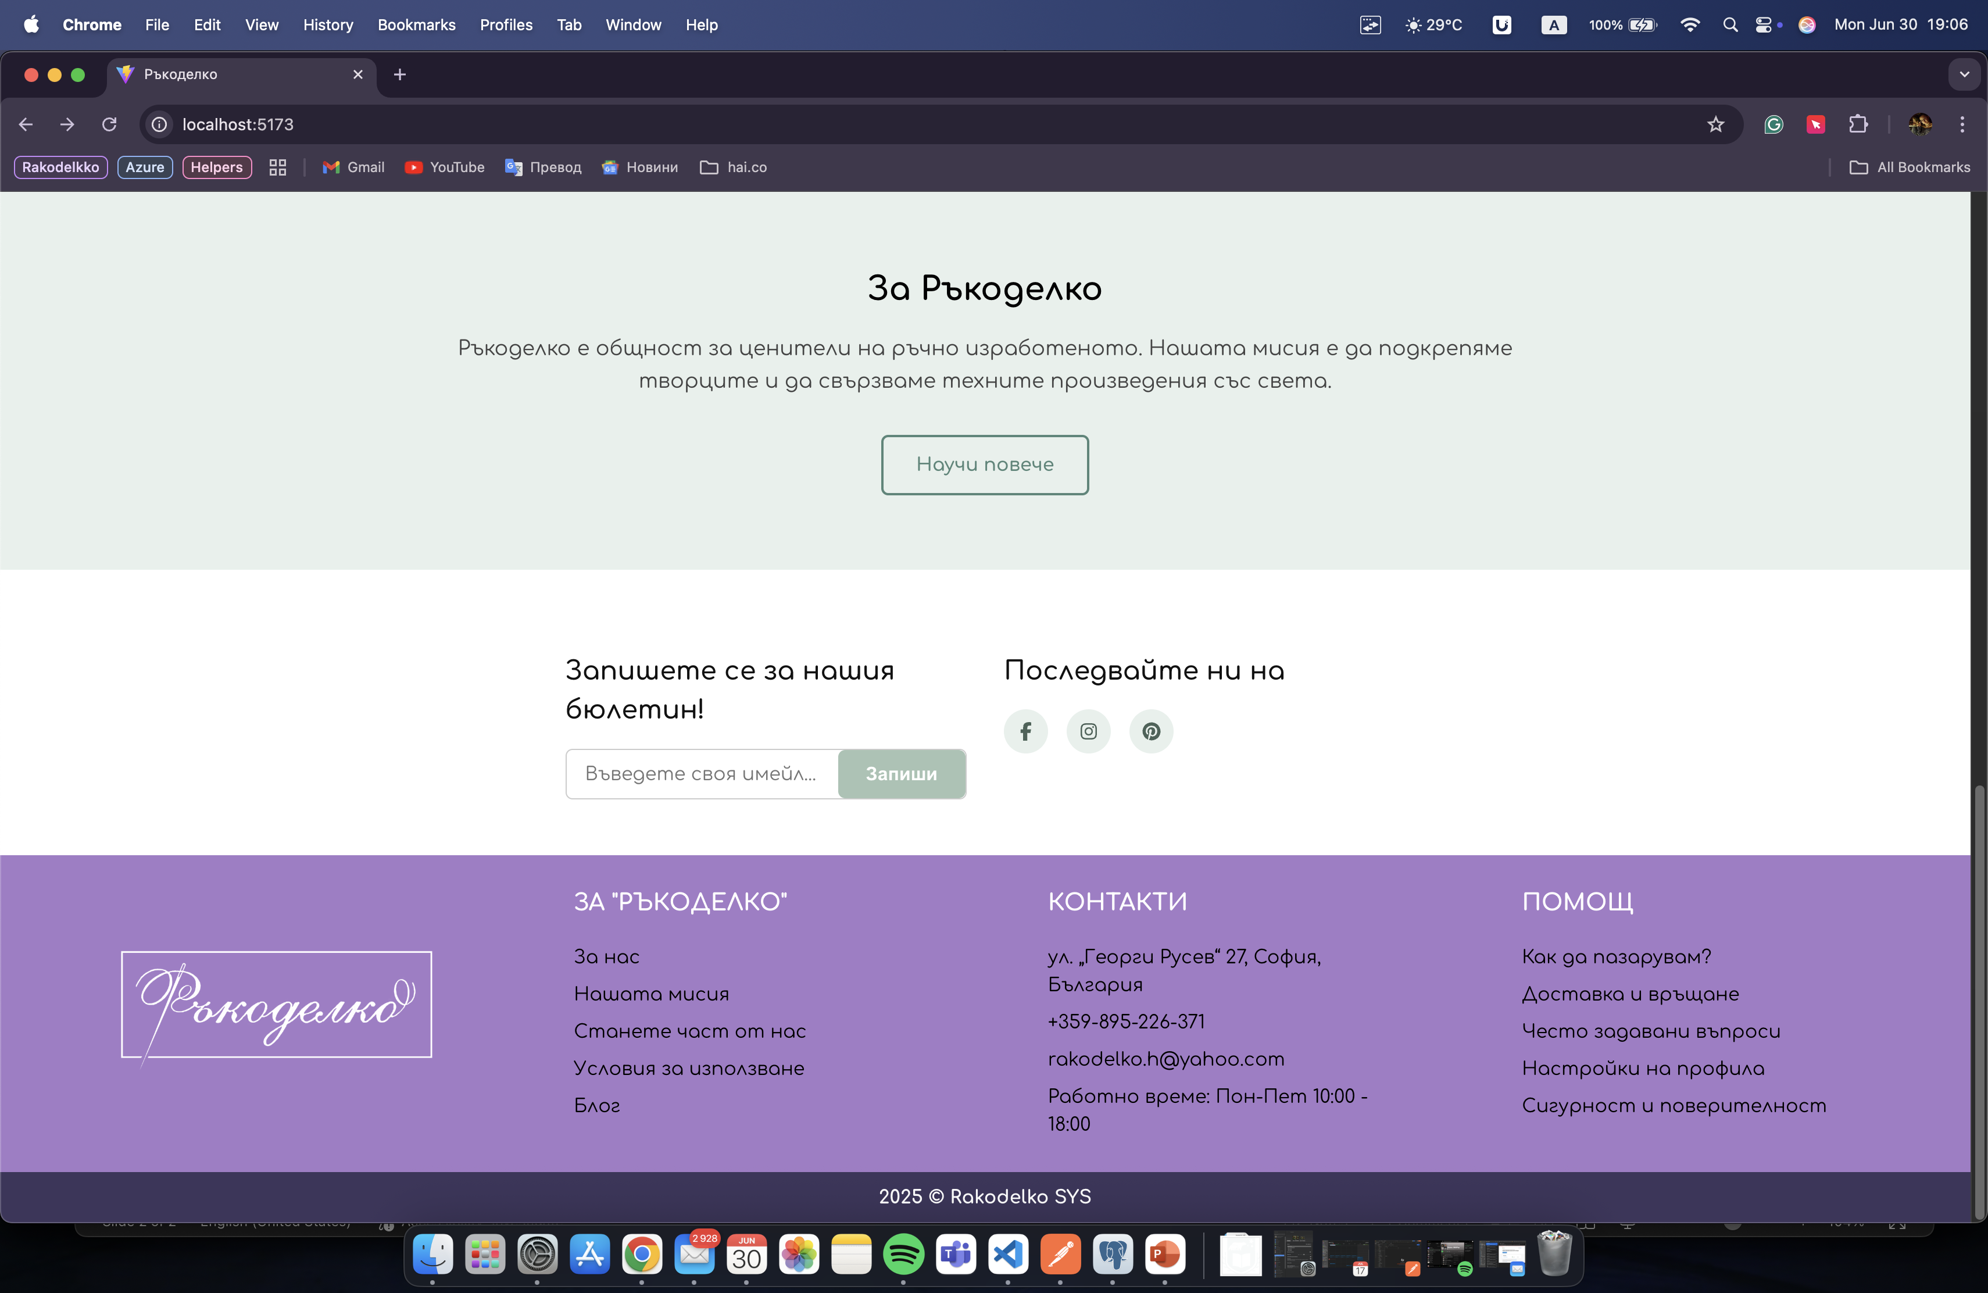

Slide 3
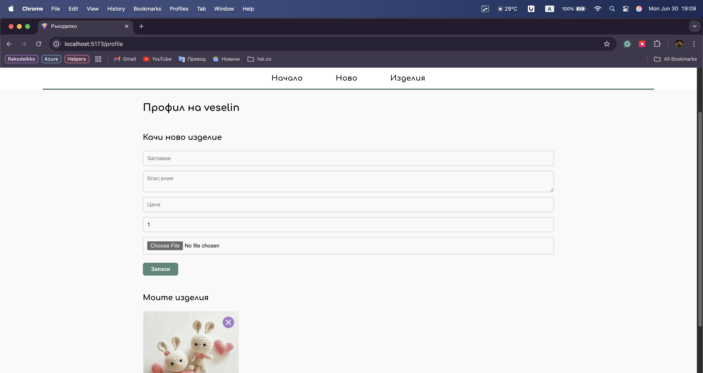
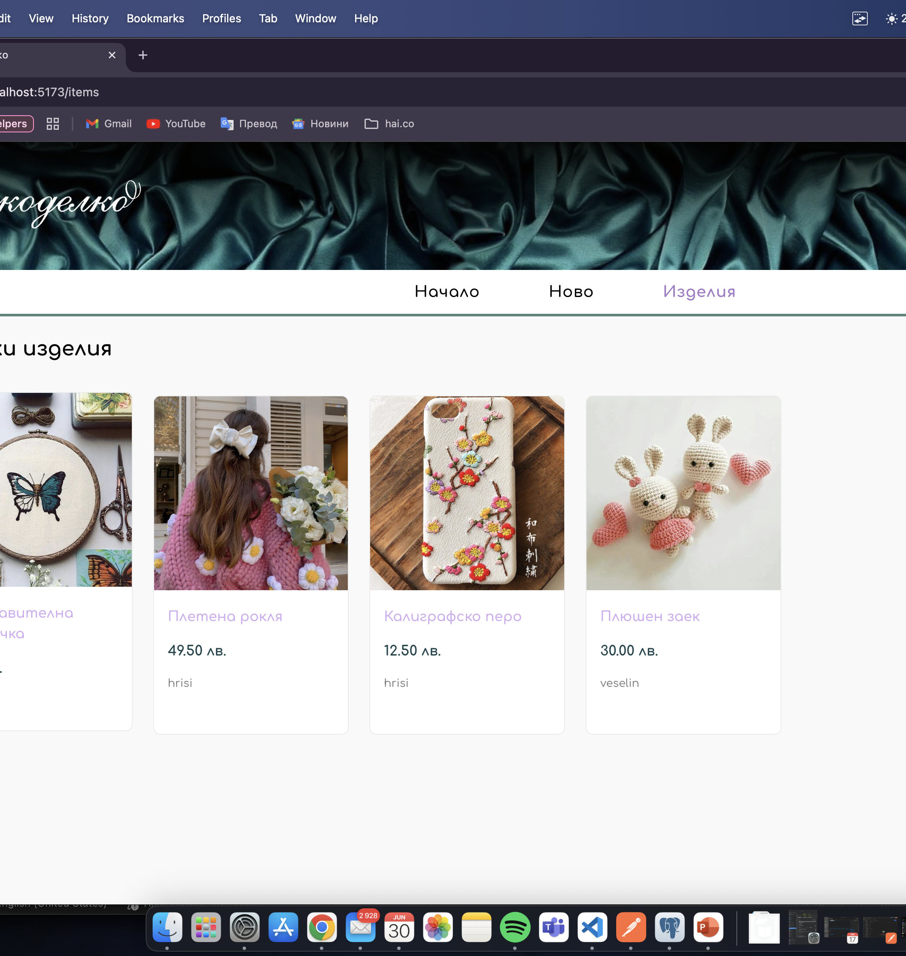
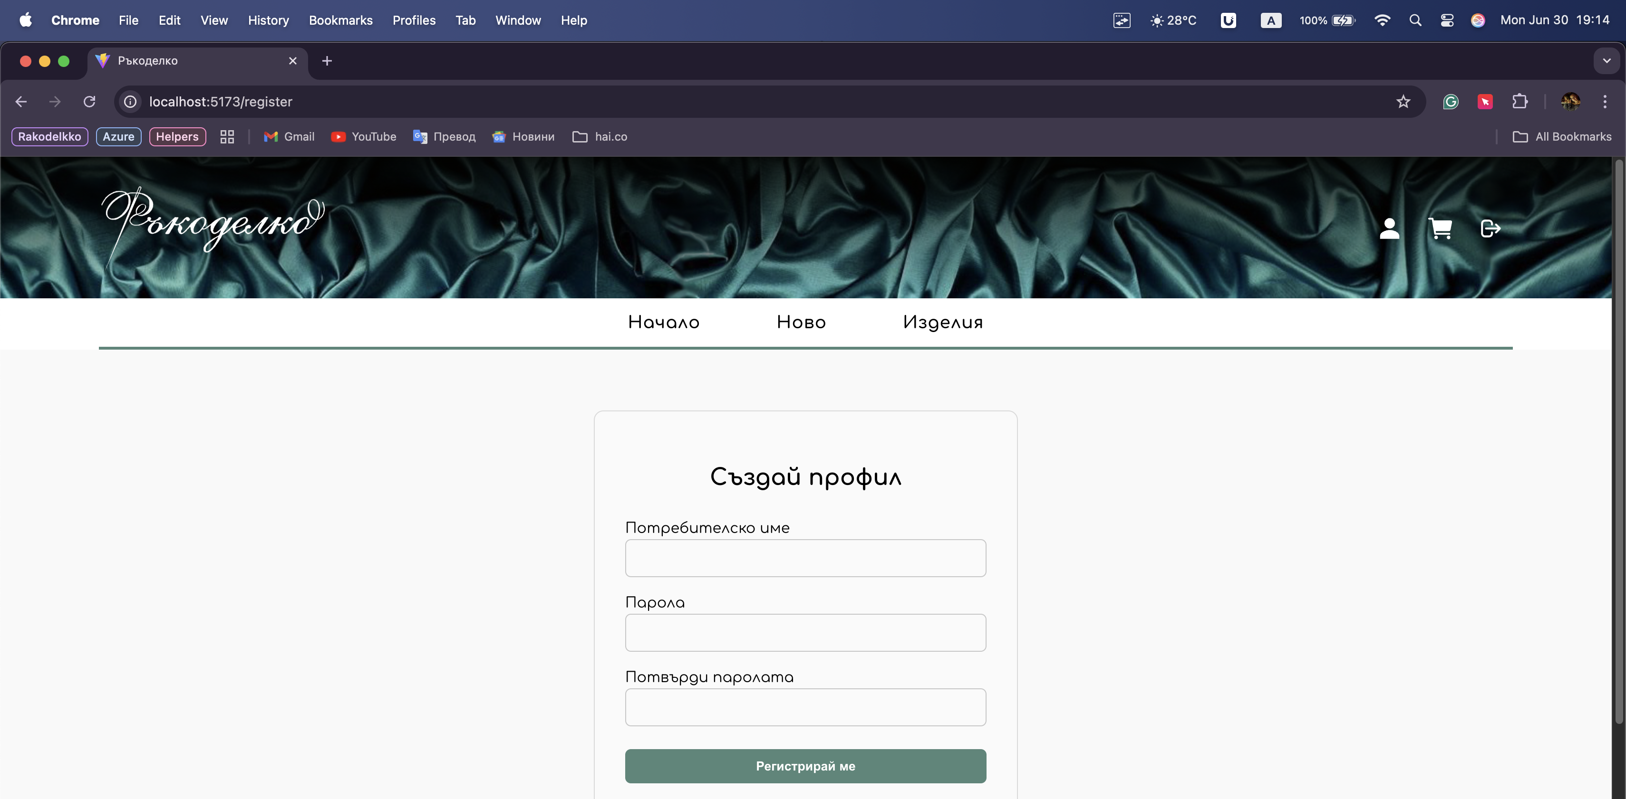

Slide 4
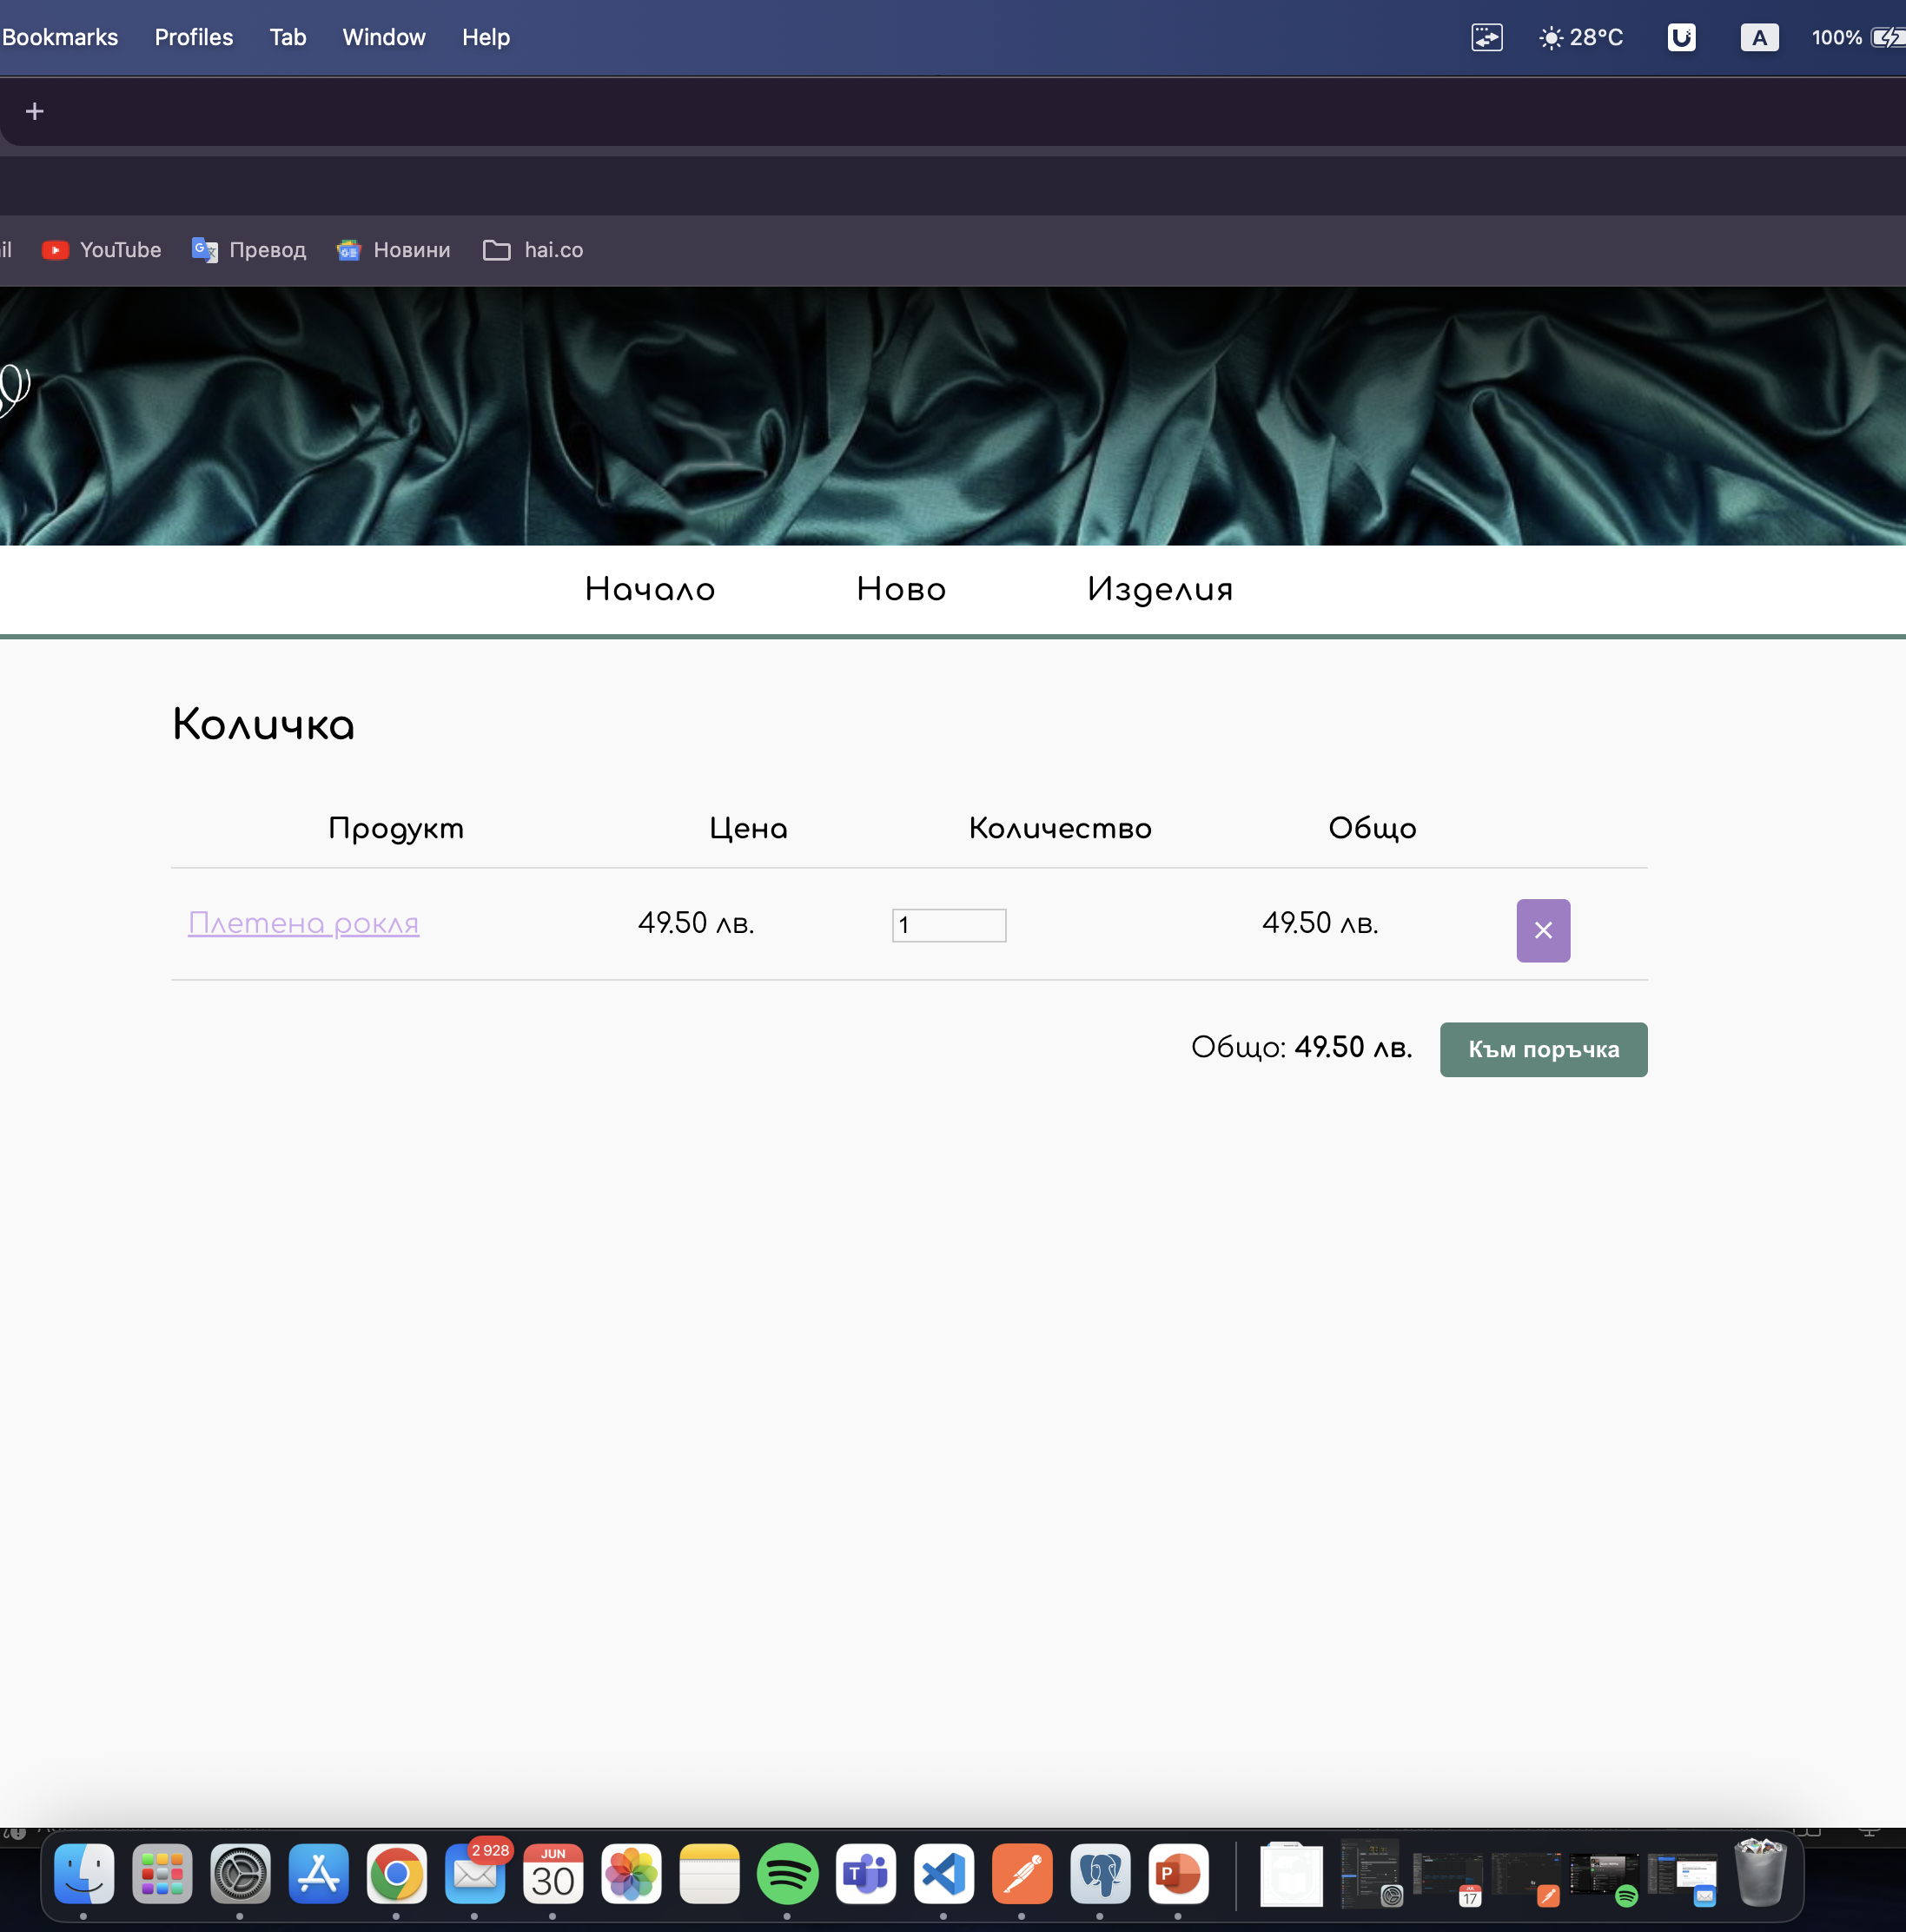
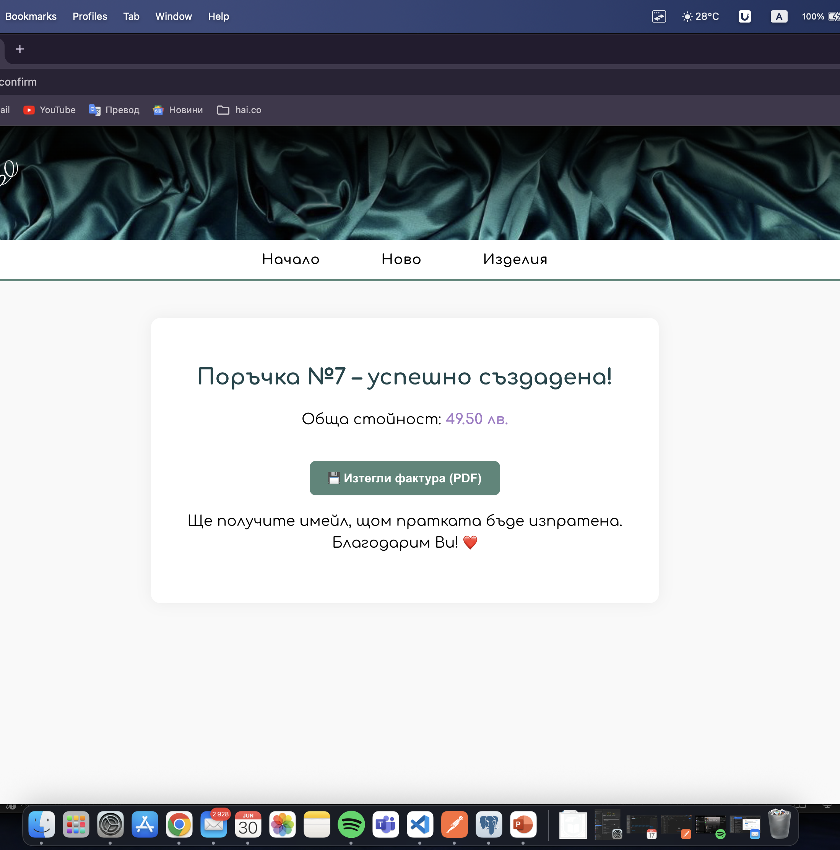

Slide 5
Users | GET User Data for all Users and POST new User Data (ID is auto-filled by RakodelkoSYS and modified entity is returned as result from POST request). Available only for Administrators. | /api/users
User | GET, PUT, DELETE User Data for User with specified userID, according to restrictions described in UCs. | /api/users/{userID}
Login | POST User Credentials (e-mail address and password) and receive a valid Security Token to use in subsequent API requests. | /api/auth/login
Logout | POST User Credentials (e-mail address and password) and receive a valid Security Token to use in subsequent API requests. | /api/auth/logout
Orders | GET Order Data for User with specified orderID and POST new Order Data, according to restrictions described in UCs. | /api/orders
Items | GET Items and POST new Item (ID is auto-filled by RakodelkoSYS and modified entity is returned as result from POST request). | /api/items
Item | GET, PUT, DELETE Item Data for Item with specified itemID, according to restrictions described in UCs. | /api/items/{itemID}
Comments And Ratings | GET, PUT, DELETE Comments And Ratings for Item with specified itemID. | /api/items/{itemID}/reviews
Invoice | GET Invoice for Item if User request it. | /api/orders /{orderID}/invoice
Multimedia | GET, PUT, DELETE Pictures/Videos related to Items. | /api/items/{itemID}/media
Shipping | GET, PUT, DELETE Address Data of Purchased Item. | /api/orders /{orderID}/shipping

Slide 6
Благодаря за вниманието!

